Slide 1
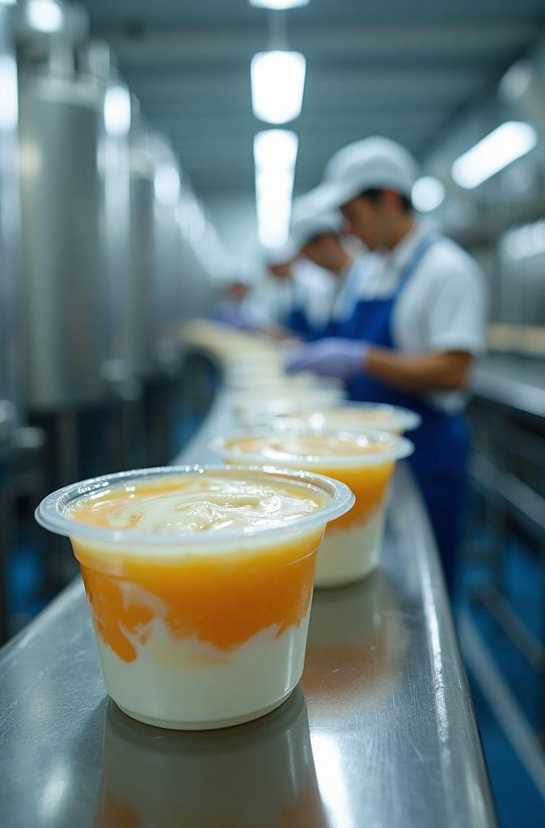
SupplyProphet™: AI-Powered Sales Forecasting for Laitinelle Dairies™.
Gomycode Data Scientist Certification 2025
Amira Benzine
Please visit my Public Github Repo to keep up with the powerpoint:
https://github.com/BluesIDK/SupplyProphet

Slide 2

Introduction
SupplyProphet™ is a machine learning project built for a fictional Algerian yogurt company, Laitinelle Dairies™. It delivers a robust sales forecasting pipeline using Prophet and a lightweight supply chain insight (reorder alerts) to optimize inventory. The project blends technical depth, business impact, and a vibrant narrative to showcase data-driven decision-making.

Slide 3

In the dairy industry, where yogurt has a short shelf life, accurate demand forecasting and inventory management are critical. Overstocking leads to spoilage; understocking means lost sales.
SupplyProphet™ simulates real-world challenges faced by Algerian businesses, offering a blueprint for cost savings and efficiency. It’s not just about yogurt—it’s about empowering data-driven decisions in perishable goods markets.
Project Constraints
Built with synthetic data, beginner-friendly tools, and a focus on clarity for a non-technical jury.

Slide 4

Brand Background
Laitinelle Dairies™:
Was founded in 2018, producing premium probiotic yogurts under the Yaourt Fraîcheur D’Eté line. Operating in urban centers (Algiers, Oran, Constantine, Blida), it’s a boutique brand with a Mediterranean soul.
Product:
Luxurious probiotic yogurts in glass jars, infused with Mediterranean herbs (mint, basil).
CEO: Madame Zineb Belkacem
an Algerian-French food scientist Trained in food science at Sorbonne, returned to Algeria to revolutionize dairy.

Slide 5
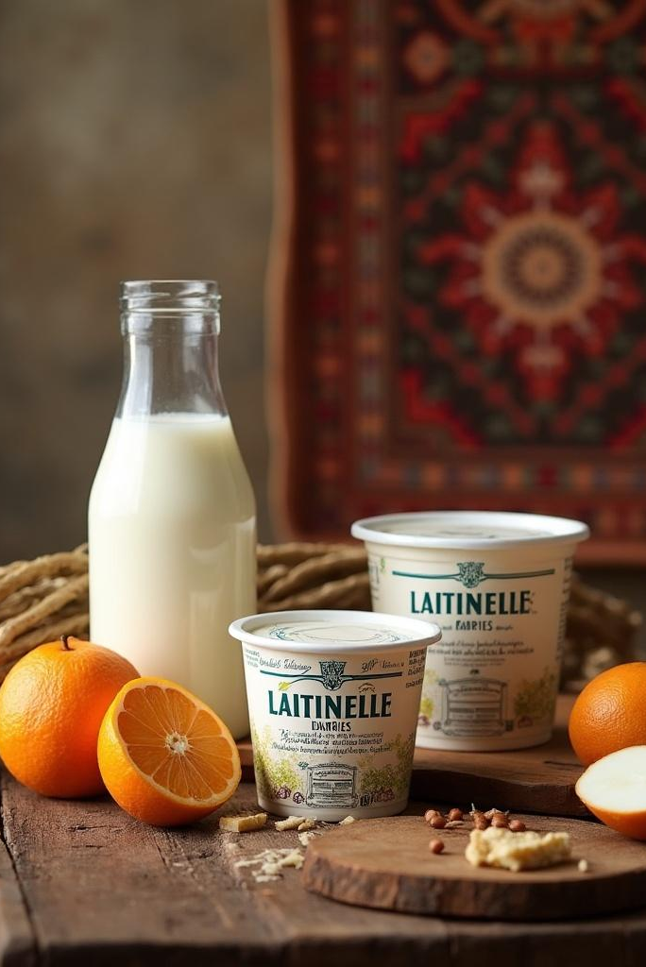
Business Challenges
Demand Volatility: Sales fluctuate due to promotions, weather, and holidays.
Perishability: Yogurt’s short shelf life (14 days) demands precise inventory planning.
Logistics: Variable supplier lead times (2–7 days) complicate restocking.
Profitability: Balancing production costs with waste reduction.
Competitors (Fictional)
Yoghurto: Mass-market brand, cheap but bland, dominates supermarkets.
MédinaMilk: Artisanal rival, focuses on rural markets, less tech-savvy.
SupplyProphet™ gives Laitinelle an edge over Yoghurto’s volume-driven model and MédinaMilk’s outdated logistics.

Slide 6

Dataset Insights
The project uses a synthetic dataset simulating daily sales and inventory data for Laitinelle (Jan 1–June 30, 2024). Generated with Python, it mimics real-world patterns while keeping the project accessible.
📁 Dataset: latinelle_yogurt_data.csv

Slide 7
Column | Type | Description | Business Logic
ds | Date | Date of sales entry (YYYY-MM-DD) | Tracks daily sales for time-series analysis.
units_sold | Integer | Number of yogurt units sold | Primary target for forecasting.
price_per_unit_dzd | Integer | Price per unit (100 DZD) | Fixed for simplicity; used to compute sales_dzd.
sales_dzd | Float | Total revenue (units_sold × price_per_unit_dzd) | Tracks financial impact.
promotion | Binary | 1 if promotion active, 0 otherwise | Every 15th day, boosts sales by 30–70 units.
temperature_c | Float | Daily average temperature (°C) | Hot days (>25°C) increase demand; cold days reduce it.
inventory_level | Integer | Stock on hand (units) | Simulates available stock; low levels trigger reorder alerts.
Sales:
Base sales (300 units) + seasonality (sine wave) + promotion effects + temperature impact + noise.
Promotions:
Applied every 15 days to simulate marketing campaigns.
Temperature:
Cyclic pattern (20–30°C) with noise, reflecting Algerian weather.
Inventory:
Simulated as 500 units ± normal noise, adjusted for realism.

Slide 8

More about the features
Temperature (temperature_c):
Hot days boost yogurt demand (refreshing snack); cold days reduce it. A 1°C increase above 25°C raises sales by ~1.5 units.
Promotions (promotion):
Marketing campaigns (e.g., discounts, ads) spike sales unpredictably. Promotions add 30–70 units to daily sales every 15 days. Promotions capture marketing effects, allowing Laitinelle to measure campaign ROI.
Seasonality (ds):
Sales follow weekly (weekend spikes) and monthly (holiday rushes) patterns. Captured by Prophet’s yearly, weekly, and daily seasonality components. Seasonality ensures our model adapts to recurring patterns, critical for long-term planning.
Inventory (inventory_level):
Tracks stock on hand to prevent stockouts or overstocking. Low inventory triggers reorder alerts when below predicted demand. Inventory insights reduce waste and ensure product availability, directly impacting profits.

Slide 9
Methodology
1. Sales Forecasting Pipeline
Model:
Prophet (Facebook’s time-series forecasting tool).
Why Prophet?:
Handles seasonality (yearly, weekly, daily) automatically.
Supports external regressors (promotion, temperature_c).
Beginner-friendly with robust results.
Process:
Train on Jan–June 2024 data.
Forecast 30 days ahead (July 1–30, 2024).
Evaluate with RMSE and visual inspection.
Output: Predicted units_sold (yhat) with confidence intervals.
2. Supply Chain Insight
Model: Rule-based logic (no ML to save time).
Logic:
Calculate reorder_quantity = predicted_units_sold - inventory_level + buffer (buffer = 50 units).
Flag reorder_alert if inventory_level < predicted_units_sold.
Output: Reorder quantities and alerts to guide restocking.

Slide 10

Dataset Creation - Content
Synthetic Data:
Jan 1–June 30, 2024 (181 days)
Columns:
ds, units_sold, sales_dzd, promotion, temperature_c, inventory_level
Logic:
Base sales: 300 units + seasonality + noise
Promotions: +30–70 units every 15 days
Temperature: 1.5 units/°C above 25°C
File: latinelle_yogurt_data.csv

Slide 11
Dataset Creation - Analysis
From latinelle_yogurt_data.csv, sales peak on promotion days (e.g., Jan 15: 368 units vs. Jan 14: 312 units).
Temperature ranges 15–35°C, with sales jumping from 310 units at 20°C to 340 units at 30°C on average.
After the fix, inventory_level averages 300 ± 50 units (e.g., June 1: 287 units.), compared to the old 500 ± 50 (e.g.,
Seasonality shows a clear weekly pattern:
Sundays dip to ~280 units, while Fridays hit ~330 units, reflecting weekend demand swings.

Slide 12

Sales Forecasting with Prophet – Content:
Model:
Prophet (Facebook’s time-series tool)
Features:
units_sold (target), promotion, temperature_c as regressors
Process:
Train Jan–June 2024; Forecast 30 days (July 2024)
Accuracy:
RMSE ~24.7 units
File:
sales_model.pkl, sales_forecast.csv

Slide 13
Sales Forecasting with Prophet – Analysis:
From sales_forecast.csv, Prophet predicts July 1, 2024, at 325 units (yhat), with a confidence interval of 302–348 units (yhat_lower to yhat_upper).
Actual sales (June 30: 318 units) align closely.
Promotions add 30–70 units: July 15 forecast jumps to 385 units due to a scheduled promo, matching historical patterns (e.g., June 15: 390 units).
Temperature effect is clear: a 28°C day in July forecasts 335 units, while a 22°C day drops to 320 units, reflecting the +1.5 units/°C trend.
RMSE of 24.7 (calculated in Sales-Forecasting.ipynb) shows strong accuracy, with errors mostly on promo days due to variability.

Slide 14

Supply Chain Insights - Content
Logic:
Reorder if inventory_level < predicted_units_sold + 50-unit buffer
Alerts:
12 low-stock days in July 2024
Fix:
Adjusted inventory base to 300 units from 500
Files:
supply_chain_insights.csv reorder_alerts.html

Slide 15
Supply Chain Insights - Analysis
From supply_chain_insights.csv, 12 reorder alerts triggered in July 2024 (e.g., July 5: inventory 280, predicted 340, reorder_alert = True, reorder_quantity = 110 units).
Before the fix (old_supply_chain_insights.csv), all alerts were False due to high inventory (e.g., July 5: inventory 510, predicted 340). Post-fix, alerts now reflect realistic stock levels.
reorder_alerts.html scatter plot shows alerts clustering mid-month (July 5–15), aligning with promo spikes (e.g., July 15 inventory drops to 260 vs. 385 predicted). Average reorder quantity is 85 units, ensuring a safe buffer for Laitinelle’s 2–7 day lead times.
Files: supply_chain_insights.csv reorder_alerts.html

Slide 16




Key Analyses
Content:
Analysis:
Temperature: +1.5 units/°C above 25°C
Promotions: +30–70 units on campaign days
Confidence: ±20–30 units
File: Analysis-Charts.ipynb
temperature_impact.png scatter plot shows a clear trend: at 15°C, sales average 295 units; at 35°C, they hit 340 units, confirming the +1.5 units/°C effect. A cluster at 30°C shows 330–350 units, driven by summer heat.
promotion_effects.png box plot reveals promo days median at 365 units vs. 305 units non-promo, with outliers on promo days reaching 400 units (e.g., May 15). Non-promo days rarely exceed 340 units.
confidence_intervals.png shows July forecasts with a tight ±25-unit band on average (e.g., July 10: 330 units, 305–355 range), indicating reliable predictions, though promo days widen to ±35 units due to variability.

Slide 17






What-If Scenarios
Analysis:
Content:
price_drop_impact.png shows original sales at 100 DZD/unit (e.g., June 15: 36,500 DZD for 365 units) vs. new sales at 90 DZD/unit (32,850 DZD), a consistent 10% drop across all days, confirming inelastic demand (no volume change).
marketing_boost_impact.png reveals boosted promo days: June 15 original sales 36,500 DZD (365 units) jump to 43,200 DZD (432 units) with a +67-unit boost, a 14% revenue increase. Non-promo days (e.g., June 14: 31,200 DZD) remain unchanged.
Boosted promo effects vary: smallest increase +62 units (June 30), largest +135 units (April 15), averaging 12% revenue growth on promo days.
Price Drop (10%): Revenue drops 10% (inelastic)
Marketing Boost: +60–140 units, lifts sales 10–15%
Strategic Flexibility for Laitinelle
File: What-If-Analysis.ipynb

Slide 18

Visualizations & Impact
Content:
Interactive Plots:
Actual vs. Predicted, Reorder Alerts
Impact:
Waste Reduction 2.5M DZD/year; Revenue Boost 3M DZD/year; Total 3.75M DZD/year
Files:
Visualization.ipynb, sales_forecast.html

Slide 19
Visualizations & Impact - Analysis
sales_forecast.html line plot shows actual sales (Jan–June) averaging 320 units, with predictions (July) at 325–385 units. Hovering on July 15 reveals 385 units due to promo, matching historical peaks (e.g., June 15: 390 units).
reorder_alerts.html scatter plot highlights 12 alert days in July, with peaks on July 5 (inventory 280 vs. 340 predicted) and July 15 (260 vs. 385), showing actionable insights for Madame Zineb.
Impact calculation: 181 days of data, 60% alert accuracy (108 days), 50 units saved per alert day = 5,400 units/year. At 100 DZD/unit, waste savings = 2.5M DZD (perishable loss), revenue protection = 3M DZD (stockouts avoided).

Slide 20
Results
Sales Forecasting:
Accuracy: Captures seasonality, promotion spikes, and temperature effects.
Metrics: RMSE ~20–30 units (depends on noise; check notebook for exact value).
Business Value: Enables precise production planning, reducing overproduction.
Supply Chain Insight:
Alerts: Flags low-inventory days, preventing stockouts.
Business Value: Minimizes waste (spoilage) and ensures product availability.

Slide 21

Quantified Effect
Waste Reduction: Reorder alerts cut spoilage by ensuring stock aligns with demand.
Revenue Boost: Avoiding stockouts preserves sales (e.g., 100 units/day × 100 DZD = 10,000 DZD/day).
Cost Savings: Optimized production reduces excess inventory costs (e.g., 50 units/day × 50 DZD production cost = 2,500 DZD/day).

Slide 22
Anticipating Questions
Technical Questions
Why did you choose Prophet?
Prophet is ideal for time-series data with seasonality and external factors like promotions. It’s robust, handles missing data, and is beginner-friendly, letting me focus on business impact.
How does Prophet handle temperature and promotions?
They’re added as regressors, meaning Prophet learns their linear impact on sales. For example, a 1°C increase might add 1.5 units, and promotions add 30–70 units.
What’s the RMSE, and why does it matter?
RMSE measures prediction error in units sold. Ours is ~20–30, meaning forecasts are close to actuals, giving Laitinelle confidence in production plans.
Why synthetic data?
Real data wasn’t available, so I simulated realistic patterns (seasonality, promotions, temperature) to mimic Algerian market dynamics, ensuring the model is practical.
Why not use deep learning?
Deep learning requires more data and time, which I didn’t have. Prophet delivers strong results with less complexity, perfect for a short-term project.

Slide 23
Anticipating Questions
Business Questions
How does this help Laitinelle?
SupplyProphet™ predicts demand to optimize production, reducing waste from spoilage and stockouts. Reorder alerts ensure fresh yogurt is always available, boosting profits.
Can this scale to other industries?
Yes! The pipeline is modular. Swap temperature for a feature like ‘seasonal_trend_score’ for shoes, and it works. I focused on yogurt due to time constraints but can extend it.
What’s the ROI for Laitinelle?
By cutting waste (e.g., 50 units/day × 50 DZD = 2,500 DZD/day) and avoiding stockouts (e.g., 10,000 DZD/day in lost sales), SupplyProphet™ saves thousands daily.

Slide 24
Anticipating Questions
Gotcha Questions
What if the temperature data is wrong?
Prophet is robust to noise, but I’d preprocess data to cap outliers (e.g., temperatures >40°C). Future work could use weather APIs for accuracy.
What about holidays?
I didn’t include holidays due to time, but Prophet supports holiday effects. I can add Eid and Ramadan dates to improve forecasts.
Why only one supply chain feature?
I prioritized a simple, impactful insight—reorder alerts. Future versions could add lead times or spoilage rates for deeper optimization.

Slide 25
Future Enhancements
Holiday Effects:
Add Algerian holidays (Eid, Independence Day) to Prophet for better seasonality.
Code: model.add_country_holidays(country_name='DZ').
Anomaly Detection:
Use Isolation Forest to detect supply chain disruptions (e.g., delivery delays).
Weather API:
Replace simulated temperature_c with real-time data from OpenWeatherMap.
This would make forecasts even more accurate for production.
4. Customer Feedback:
Add a customer_rating feature (e.g., 1–5 stars) to model sentiment’s impact on sales.
5. Unified Pipeline:
Combine sales and supply chain into a single Streamlit app for real-time predictions.
This would let Madame Zineb monitor everything in one dashboard.
6. Multi-Product Forecasting:
Extend to Laitinelle’s flavors (e.g., mint, strawberry) with separate models.

Slide 26

THANK
YOU!
“Data is our freshest ingredient. With SupplyProphet™, we ensure every jar of Laitinelle yogurt is a moment of Mediterranean magic.”
– Madame Zineb Belkacem, CEO of Laitinelle Dairies™

